Slide 1
Overview of Visit Scheduling and Types of Follow-up Visits SCHARP

Slide 2
Scheduling Follow-up Visits
Ideally, follow-up visits will occur on the target day
A follow-up visit schedule is fixed for each participant (based on Enrollment date) and does not change based on actual visit completion date, with the exception of the Study Exit Visit.
If the visit cannot occur on the target day, it should be completed as close to the target day as possible and within the visit window.
Visit windows are continuous, so each day in follow-up is always in a window.
Notes:
When scheduling participant follow-up visits, it is ideal that visits occur on the specified target day, which is based on the date of participant enrollment. This is to ensure that the participant has access to enough study product throughout the study and that study procedures and assessments are completed on regularly timed intervals.
A follow-up visit schedule is fixed for each participant, is based on the Enrollment date and does not change based on the actual visit completion date. The exception to this is the Study Exit Visit target date and visit windows, which are based off of the actual date of the Product Use End Visit rather than the Enrollment date. The target date for the Study exit visit is 28 days after the actual day of the PUEV.
If the visit cannot occur on the pre-specified target day, it should be completed as close to the target day as possible and within the visit window.
For HOPE, Visit windows are continuous, so each day within the follow-up period will always be in a visit window

Slide 3
Visit Calendar Tool - Output
Notes:
SCHARP has provided a spreadsheet tool that can be used to generate individual follow-up visit calendars. This visit calendar tool is available to download from the study Implementation Materials subpage within the MTN025 study webpage. There are three tabs to the visit calendar tool – the first calculates the last date that the participant can enroll based on the participant’s screening visit. The second tab calculates the participant visit calendar. An example of the participant visit calendar is shown at the top of this slide. As a reminder, the participant’s Enrollment date must be entered as first step in completing this calendar. Once the enrollment date is entered, the target day and visit window for each required follow-up visit up through the Product Use End Visit (PUEV) will appear.
The third tab calculates the target day and visit windows for the Study Exit Visit. The participant’s actual PUEV date is required to be entered within the purple cell at the top of the spreadsheet in order to generate the SEV target day and visit window. The calendar can then be printed and added to the participant’s study notebook.

Slide 4
Target Days and Visit Windows
Target Visit Windows
Target visit windows for all scheduled study visits open 14 days before the target day and end 13 days after
Allowable Visit Windows
For quarterly visits, sites should complete study visits within the target window. However, if needed, it is permitted to complete the study visit within the allowable visit windows.
Allowable visit windows open 14 days before the target day and end 69 days after
Notes:
The specified target visit window for each of the study visit is 14 days prior to and 13 days after the target date. Follow-up visits can occur at any time within their respective visit windows, however, it is ideal if the visits are as close to the target days as possible.
For quarterly visits, study visits should continue to be completed within the target window, whenever possible . However, if needed, it is permitted to complete the study visit within a wider, allowable visit windows to ensure that the participant is able to come into the clinic to complete visit study procedures before her next visit.
Allowable visit windows for quarterly visits open 14 days before the target day and end 69 days after the target day and are contiguous for HOPE. A visit will not be considered overdue or missed until the allowable visit window has lapsed.

Slide 5
Target Days and Visit Windows – A Visual
Monthly Visits: visit window starts 13 days before the target day, and ends 14 days after target day
Month 1
Visit Window
Month 2
Visit Window
Month 3
Visit Window
-13 Days
+14 Days
-13 Days
+14 Days
-13 Days
+14 Days
Target Day
Target Day
Target Day
Target Day = 28 Day 56 Day 84
Notes:
Here is a visual representation of the monthly visit windows up through month 3. As you can see here, the target day for the Month 1 visits is 28 days after the participant’s Enrollment Date. The Month 2 target day is 56 days after the Enrollment visit and 28 days after Month 1’s target day. Similarly, the month 3 target day is 84 days after the enrollment date and 28 days after the Month 2 target day.
The target windows for each of the monthly visits are 13 days prior to and 14 days after the target date and are contiguous for ASPIRE. Follow-up Visits can occur at any time within their respective visit windows, however, it is ideal if the monthly visits are as close to 28 days apart as possible.

Slide 6
Target Days and Visit Windows – A Visual
Quarterly Visits:
Target visit window starts 13 days before and ends 14 days after target day
Allowable visit window starts 13 days before and ends 69 days after target day
Month 6
Visit Window
Month 9
Visit Window
Month 12
Visit Window
+69 Days
+69 Days
+69 Days
-13 Days
-13 Days
-13 Days
+14 Days
+14 Days
+14 Days
Target Day
Target Day = 168
Target Day = 252
Target Day = 336
Notes:
Here is a visual representation of the quarterly visit windows up through month 12. As you can see here, the target day for the Month 6 visits is 168 days after the participant’s Enrollment Date. The Month 9 target day is 252 days after the Enrollment visit and 84 days after Month 6’s target day. Similarly, the month 12 target day is 336 days after the enrollment date and 84 days after the Month 9 target day.
The target windows for each of the quarterly visits are 13 days prior to and 14 days after the target date and are identical to the monthly target visit windows. To ensure that the quarterly visit windows are contiguous and to ensure that the participant can return to the clinic to complete study procedures at any point before her next scheduled stud visit, in addition to the target window, an allowable window has been established. The allowable visit window for each quarterly visit starts 13 days before the target day and ends 69 days after the target day. Again, it is preferable and ideal that a study visit be conducted within the target window, however, if needed, a study visit can be conducted within a visit’s allowable window.

Slide 7
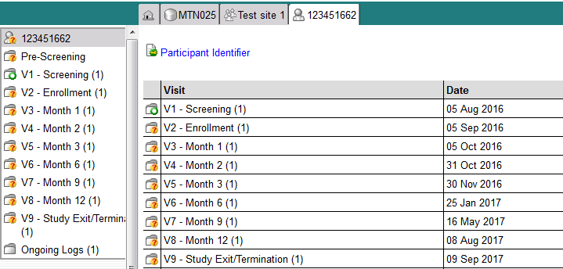
Visit Numbers
eCRFs are set up within pre-defined Medidata Rave visit folders, so the visit name and number automatically appear
Date column will populate with target day. Once the visit date has been entered for the actual visit, this will be updated with the actual visit date.
Notes:
The eCRFs in the study database are set up within pre-defined study visit folders, so that the visit name and number automatically appear and do not need to be manually entered for required study visits. For example, the visit folder for the participant’s screening visit is labeled here as “V1 – Screening” with 1 being the visit number of the each participant’s screening visit. The Enrollment Visit number is ‘2’, the Month 1 visit number is “3” and so on and so forth.
Visit numbers are used to help indicate at which point in a participant’s trial participation an event occurred. They are helpful when reviewing reports and conducting study analyses.
Each of the required forms for a given visit will automatically populate within the applicable visit folder.
On the participant’s home page within Medidata Rave, a visit calendar will also populate. The date column will populate with the target day when the Enrollment date has been entered. Once the visit day has been entered for the actual visit, this will be updated with the actual visit date.

Slide 8
Visit Numbers Example
Visit | Visit Number
Screening | 1.00
Enrollment | 2.00
Month 1 | 3.00
Month 2 | 4.00
Month 3 | 5.00
Month 6 | 6.00
Month 9 | 7.00
Month 12 (Scheduled PUEV) | 8.00
Study Exit/Termination | 9.00
Notes:
A list of visit numbers associated with each scheduled study visits is provided in a table similar to the one provided on this slide within the Data Collection section of the SSP. As noted in the previous slide, the visit number for the Screening Visit is visit number 1. Each visit number has two additional spaces designated after the decimal place to allow for additional unscheduled, or interim visits, to occur between regularly scheduled visits. These visits numbers should be documented on any paper CRFs completed prior to data entry as well as on LDMS specimen tracking sheets to correctly identify the visit number that corresponds to each specimen collected.

Slide 9
Missed Visits
A follow-up visit is missed once the window for the visit closes and the participant has not completed any part of the required follow-up visit
Example: An enrolled participant does not report to the clinic for her Month 1 Visit until 48 days after enrollment. The Month 1 Visit is considered missed.
Notes:
A follow-up visit is considered missed once the target and if applicable, allowable windows for the visit closes and the participant has not completed any component, procedure or assessment of the required follow-up visit.

Slide 10
Missed Visits
Missed visits are documented in the study database using the Missed Visit CRF
Do not complete/submit any other CRFs for the missed visit
Protocol Deviation Log is not completed/required
Missed Visit CRF will let SCHARP know not to expect any other forms for that participant for that specific visit
Notes:
Missed visits are documented in the study clinical database using the Missed Visit CRF
If a study visit is missed, do not complete/submit any other CRFs besides the missed visit CRF. While a missed visit is considered a protocol deviation, a separate Protocol Deviation Log is not required and should not be completed as the Missed Visit CRF is sufficient documentation of this protocol deviation.
The Missed Visit CRF will let SCHARP know not to expect any other forms for that participant for that specific visit.

Slide 11
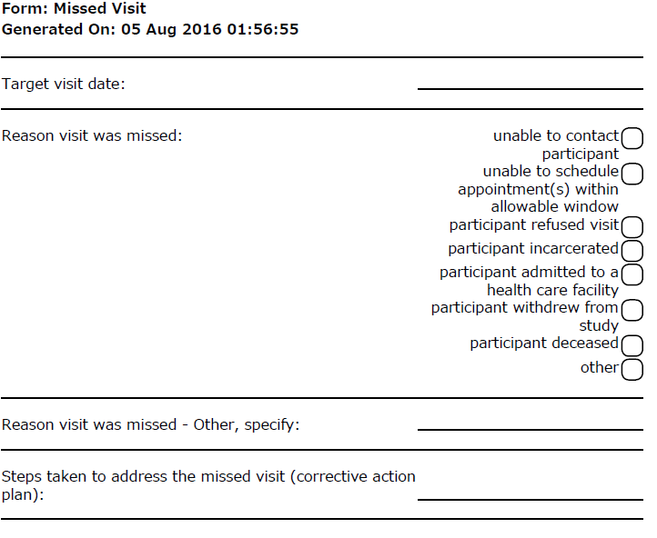
Missed Visits CRF
A corrective action plan should be completed on this form in lieu of a Protocol Deviations Log form
Notes:
This is an example of the HOPE Missed Visit CRF. Enter in the target visit date based on the target date specified within the participant’s specific visit calendar. The target date must be entered as this will generate the participant’s next visit folder within Medidata Rave. Select the main reason why the visit was missed. If the reason for the missed visit is not provided on the form, mark ‘other’ and provide details to document the reason that the visit was missed.
The last item asks for the corrective action plan to address the missed visit and is completed in lieu of completion of a separate protocol deviations log CRF.

Slide 12
Missed Visits
If the participant did not complete the visit, as specified on the Date of Visit CRF, the Missed Visit CRF will be added to this visit’s folder.
Notes:
In Medidata Rave, the Missed Visit CRF is triggered by the Date of Visit Form, which is the first form that you will complete for each study visit. If ‘No’ is selected for “Did the participant complete this visit?”, then the Missed Visit form will dynamically be added within the participant’s visit folder. Any other required forms for this visit will be removed from the visit folder automatically so that the only form provided for this visit is the missed visit CRF.

Slide 13
Interim Visits
Interim visit = visit/contact that occurs between required follow-up visits
Required monthly/quarterly visit procedures are not conducted
Either not needed (required visit already completed) or not the purpose of the visit
Examples:
A participant completes all required evaluations for her Month 3 visit on the target day. She returns to the clinic 5 days later to request a new ring.
A participant completes her Month 9 visit as scheduled. Her Month 12 visit window opens on July 12. The participant reports to the clinic unexpectedly on July 13 to report new genital AE symptoms.
A participant completes all required evaluations for the Month 3 visit on the target day, July 15. Her labs do not come back until July 18, and she has a grade 4 ALT. The site contacts her by phone on July 18 and instructs her to remove the ring, as she is being placed on clinical product hold due to the ALT result.
Notes:
An interim visit occurs when there is contact with the participant, but required follow-up visit procedures are not done, either because the required follow-up study visit has already been completed, or it is too early in the visit window to complete the required visit.

Slide 14
Interim Visit Documentation
If an interim contact results in at least one newly-competed CRF, the visit is assigned an interim visit code
If the only new entry is to the Con Meds Log, no interim visit code needs to be assigned and no Follow-up Visit Summary is needed; just document visit in chart notes
Interim visit number will let SCHARP know an interim visit has occurred
This will need to be written in on the Follow-up Visit form, and any other applicable paper completed CRFs
In Medidata, the interim visit number will be documented within “Interim Visit Procedures” form
Notes:
All interim visits/contacts with the participant should be documented in a chart note. Additionally, if the interim contact results in at least one newly-completed Medidata Rave CRF, the interim visit is assigned an interim visit number, which we will review in a few slides.
The Follow-up Visit Summary CRF, which is required at each scheduled or interim study visit, will document whether the visit is a required visit or an interim visit.
The Interim visit number will let SCHARP know that an interim visit has occurred and will need to be written in on the Follow-up Visit Summary form, and any other applicable paper CRFs that are completed for each interim visit. In Medidata, this number will be inputted within “Interim Visit Procedures” form. Let’s take a look at the process for adding interim visits into Medidata Rave now.

Slide 15
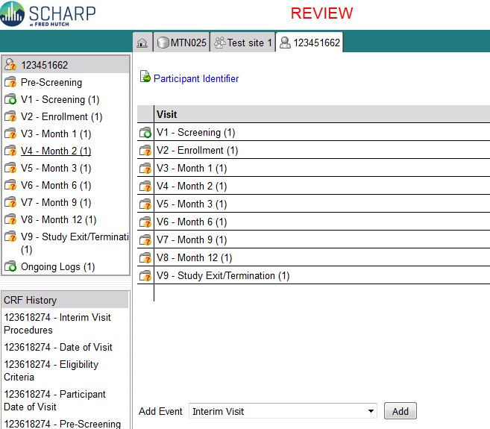
Interim Visits in Medidata Rave
Notes:
To add an interim visit to a participant’s list of visit folders, or casebook within Medidata Rave, select “Interim Visits” from the dropdown menu in “Add Event” which appears on the participant’s homepage. Then click “Add”. An interim visit folder will be added to the bottom of this participant’s casebook. Click on this visit folder to enter data for this interim visit.

Slide 16
Interim Visit Procedures Form
Interim Visit Procedures form
Lists all potential forms that could be completed for interim visit – select “Yes” or “No” for each form
Selecting “Yes” will dynamically add each form to the current Interim Visit folder
If completing paper CRFs, each applicable form that results in data collection will need to be printed and then entered into Medidata Rave.
Notes:
Since we don’t know the reason for the interim visit or what CRFs are to be completed, you will need to tell us. This is done using the Interim Visits Procedures form which lists all of the potential forms that could be completed for an interim visit. Select yes or no for each form listed within the eCRF. Note that the Follow-up visit summary CRF is a required form at all interim visits and will need to be added. If you forget to select ‘yes’ for the Follow-up Visit Summary CRF, the system will remind you to select this item when you save the eCRF. By selecting yes for each form, this will dynamically add each applicable form to the specific interim visit folder.
If completing a paper interim Visit procedures CRF prior to data entry into Rave, each applicable form that results in data collection will need to be printed and then entered into Medidata Rave.

Slide 17
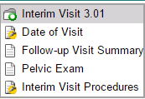
Interim Visit Procedures Form
Notes:
Let’s take a look at an example of adding eCRFs to an interim visit using the interim visit procedures form.
In this example, an interim visit was conducted in between a participant’s Enrollment Visit and her Month 1 visit. The Interim Visit Procedures lets SCHARP know that in addition to the required Follow-up Visit Summary CRF, an as indicated Pelvic Exam was completed at this visit. When the Pelvic Exam CRF is selected on this form, the CRF is dynamically added to the interim visit folder together with the follow up visit summary CRF. Remember that a Follow-up Visit Summary CRF is a required form for Interim Visits and should always be selected within Interim visit Procedures CRF.

Slide 18
Interim Visit Numbers
Interim visit numbers use the digits to the right of the decimal point – assign starting with .01
For HOPE, the interim visit number format is XX.XX
For the numbers to the left of the decimal point, use the visit number of the most recently-required visit, even if the interim visit date is in the next visit’s window
The interim visit number will be a number in-between the two visit numbers when the interim visit occurred
Example: A participant completes her Month 9 visit (visit number = 7.00) on the target day. She returns to the site one day later to report a new genital symptom. This interim Visit is assigned a visit number of 7.01.
Notes:
As a reminder, if an interim contact results in at least one newly-competed CRF, the visit is assigned an interim visit number
Note that interim visit numbers are not used for visits/contacts between the Screening Visit and Enrollment Visit, as these contacts are considered part of the screening process.
For interim visits occurring after the Enrollment Visit and onwards, interim visit numbers are assigned using the following guidelines:
To the left of the decimal point, record the visit number of the most recently required follow-up visit, even if the visit was missed and/or if the participant is within the next visit’s window.
To the right of the decimal point:
.01 should be entered for the first interim visit after the most recently-required visit,
.02 should be entered for the second interim visit after the most recently-required visit,
.03 should be entered for the third interim visit after the most recently-required visit, and so on.
As an example, a participant completes her Month 9 visit (with visit number equal to 7.00) on the target day. She returns to the site one day later to report a new genital symptom. This interim Visit is assigned a visit number of 7.01.

Slide 19
Split Visits
A scheduled visit = split visit when the required visit procedures are split (completed) over 2 or more days
The days must all fall within the specified visit window; any required procedures not done within the visit window are missed procedures
For split visits, only 1 Follow-up Visit Summary is completed
Date of Visit form is the date of the first part of the split visit
All CRFs completed for the split visit are within the participant’s scheduled visit folder (same visit name and number)
Interim visits cannot be split! Complete 1 Follow-up Visit Summary for each interim visit (i.e., for each calendar day)
Notes:
A visit is considered a split visit when the required visit procedures are split (done) over 2 or more days. The days must all fall within the specified target, or if applicable, allowable visit window; any required procedures not done within the visit window are considered missed procedures
When split visits occur, the CRFs completed for the visit are all assigned the same visit number, even though the dates will differ between some of the CRF as procedures will be conducted across two or more days.
For example, a participant comes in on her Month 6 target day of 23-AUG-16 and completes all required visit evaluations except pregnancy testing. She returns on 26-AUG-16 (still within the visit window) and provides a urine sample for pregnancy testing. All CRFs dated 23-AUG-16 and 26-AUG-16 are assigned the same visit number of “6.00”. and are within her Visit 6 – Month 6 folder. The collection date for the pregnancy test will be dated 26-Aug 16.
Interim visits cannot be split. Complete a FVS form for each interim visit. In other words, each calendar day on which interim visit procedures are performed is considered a unique interim visit).

Slide 20
PUEV, Study Exit and Early Termination Visits…….

Slide 21
PUEV Timing and Required Procedures
Product Use End Visits currently assigned to V8-Month 12 folder
The PUEV is not when a ppt is permanently discontinued from product prior to study end
Indicate “PUEV” on Follow-up Visit Summary
Notes:
Each participant’s Product Use End Visit is currently assigned to the V8 – Month 12 folder within Medidata Rave, per the protocol visit schedule.
The PUEV is not defined as the visit at which when a ppt is permanently discontinued from product prior to study end. Rather, the PUEV is the visit on which a participant is expected to complete use of the vaginal ring, per protocol. In other words, this visit is still considered the PUEV even if the participant has previously discontinued from study product at an earlier date.
To identify that the visit is the participant’s PUEV, indicate “PUEV” on the Follow-up Visit Summary and select “yes” for “Is this visit a PUEV, scheduled study exit visit or early termination”?

Slide 22
Scheduled Study Exit/Termination
Main purpose is to assess for delayed HIV seroconversion after product use has ended
Participant identified as HIV infected will not complete this visit
Target day is 28 days after the PUEV, at the next regularly-required visit
Should allow for at least 2 weeks between PUEV and SEV
Currently assigned to V9 – Study Exit/Termination Visit
Indicate “Scheduled termination” on Follow-up Visit Summary
Since there is no Sample 2 collection, there should not be any post-termination visits requiring CRFs
Notes:
The end of data collection of the study will occur at the participant’s Study Exit Visit or Termination Visit.
The main purpose of this study visit is to assess for delayed HIV seroconversion that study product might have masked while the participant was using the vaginal ring. As such, participants who are identified, per protocol, as HIV infected, will not complete this visit.
As discussed at the top of this presentation, the target day for the SEV is 28 days after the actual date of each participant’s PUEV. However, the SEV should not be scheduled less than 2 weeks after the completion of the PUEV as to allow for time to identify delayed seroconversion. This Study exit visit is assigned to the V9 – Study Exit/Termination Visit within Medidata rave.
To identify that the visit is the participant’s study exit visit, indicate “scheduled termination” on the Follow-up Visit Summary after selecting “yes” for “Is this visit a PUEV, scheduled study exit visit or early termination”?

Slide 23
Early Termination Visits
Can occurs at any point in the study if a ppt withdraws consent
If consent withdrawn, complete as many of the Early Termination visit procedures as possible
Early Term. = PUEV + Study Exit/Term. Procedures
Use Early Termination CRF visit packet; refer to Early Termination Visit in Schedule of Forms (Data Collection SSP)
Select “Early Termination” on Follow-up Visit Summary CRF
Ppt should not be contacted for future visits, but do ask them if they want to be contacted when study results are available
Notes:
An early termination visit can occur at any point in the study if a participant withdraws her consent from study participation. If an early termination occurs, try to complete as many of the expected early termination procedures as possible, as specified in the schedule of forms located with the Data Collection SSP. The Early Termination procedures are a combination of the PUEV required procedures together with the study exit visit procedures.
To identify that the visit is the participant’s early termination visit, indicate “early termination” on the Follow-up Visit Summary after selecting “yes” for “Is this visit a PUEV, scheduled study exit visit or early termination”? The Termination CRF will automatically be added to the visit folder at which the early termination is taking place. Additional required PUEV CRFs will need to be added by selecting them on the Additional Study Procedures Y/N CRF if the forms are not already there.
As a reminder, participants should not be contacted for future visits, but do ask them if they would like to be contacted as study results become available.

Slide 24
Questions?
Contact Melissa Peda (mapeda@scharp.org) and Jen Berthiaume (jberthia@scharp.org)
Notes:
Thank you for joining the SCHARP visit scheduling and visit type training module. Please don’t hesitate to contact SCHARP for any questions regarding visit scheduling and types of HOPE study visits or questions on any other components outlined in this presentation.

